Slide 1

Agile Metrics & Tools
- Prof K G Krishna

Slide 2



Text/Reference Books
T1
T2
Compliments of IBM
➔ As this field is evolutionary, the student is advised to stay tuned to the current and emerging practices by referring to their own organization’s documentation as well as Net sources

Slide 3
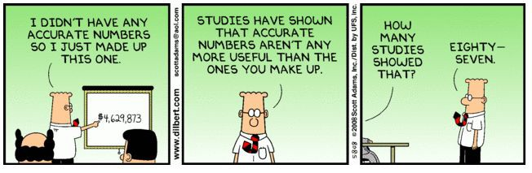
Topics
Agile Metrics & Tools
Overview of Agile Metrics
Tools for Metrics

Slide 4
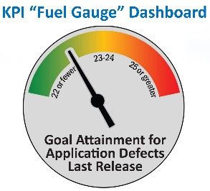
Metrics – Track Performance / Progress
Metrics is a Measure or combination of Measures for quantitatively assessing, controlling or improving a Process or Product or Team.
In Agile, We use Metrics for Planning, Inspecting, Adapting and Progress Tracking of Software Development
Metrics – Quantity /w Unit of Measure; Ratio (e.g. Schedule Overrun, Effort Overrun, Defect Discovery (rate), Project Size (Stories, Components,…), etc.
Metrics (Term adopted in Software Industry) vs. Measures vs. Indicators (Leadng/Lagging) / KPI (strategic, tied to an objective or goal, trend, range,…)
Metrics are Relative (need Baselining) and Organization/Project/Product-centric
Typical Metrics in Software Projects:
Success metrics
Time and Cost metrics
Satisfaction metrics

Slide 5
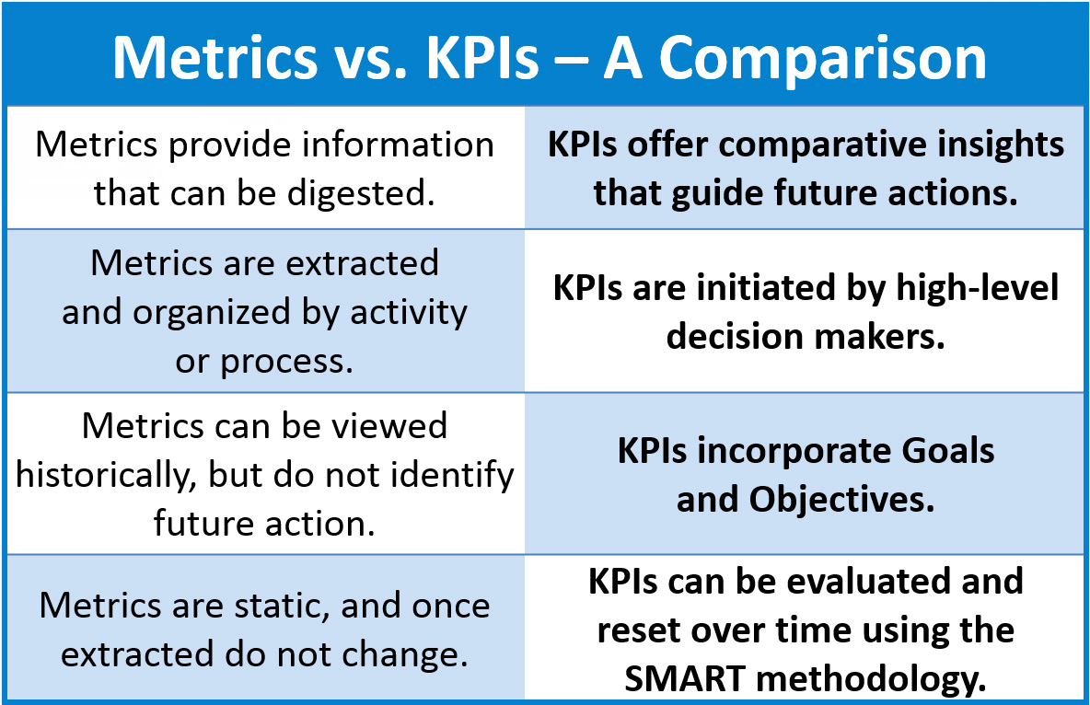
Metrics must be Actionable (➔KPIs)
Source: appdevelopermagazine.com

Slide 6
Ten Key Metrics for Agile Project Management
Sprint goal success rates: A successful sprint should have a working product feature that fulfills the sprint goals and meets the scrum team’s definition of done: developed, tested, integrated, and documented.
Defects: Defects are a part of any project, but agile approaches help development teams proactively minimize defects
Total project duration: Agile projects get done quicker than traditional projects.
Time to market: Time to market is the amount of time an agile project takes to provide value,
Total project cost: Cost on agile projects is directly related to duration
Return on investment: Return on investment (ROI) is income generated by the product, less project costs
New requests within ROI budgets: Agile projects’ ability to quickly generate high ROI provides organizations with a unique way to fund additional product development.
Capital redeployment: On an agile project, when the cost of future development is higher than the value of that future development, it’s time for the project to end.
Satisfaction surveys: A scrum team’s highest priority is to satisfy the customer.
Team member turnover: Agile projects tend to have higher morale. One way of quantifying morale is by measuring turnover

Slide 7
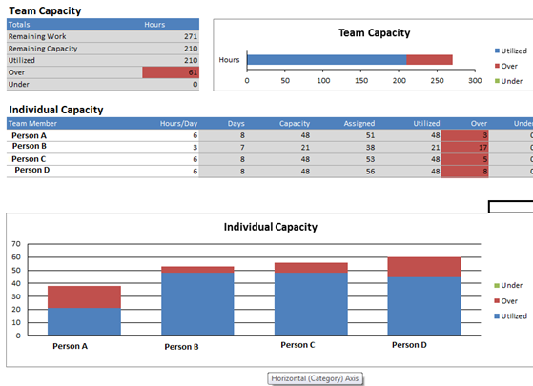
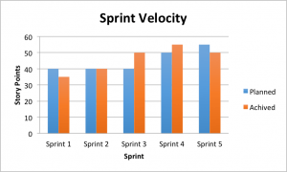
Sprint Estimation Metrics
Source: blogs.technet.microsoft.com

Slide 8
Tools for Agile Management ➔➔

Slide 9
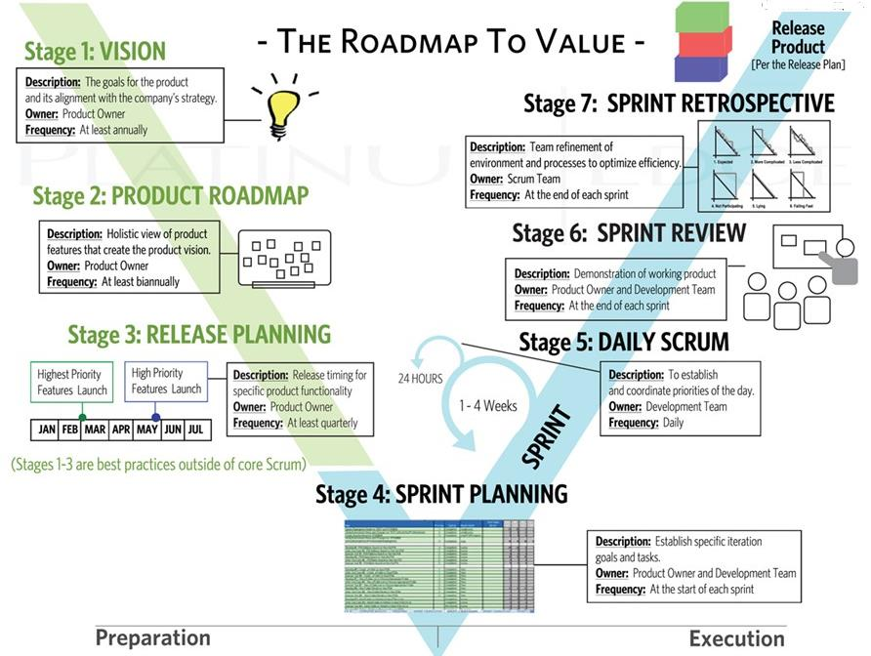
Metrics/Tools at every Stage of Agile Life-cycle
Source: (T2)

Slide 10
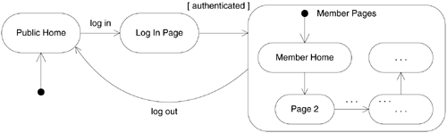
Tools for Agile Project/Knowledge Management
Project Wiki Webs (as “the simplest online Web database that could possibly work” – Ward Cunninghan, Founder of XP)
Wikis are popular tool on Agile projects to capture project information; when used as Knowledge sharing tool, Wiki allow people to edit Web pages using only their browser, create new pages and hyperlinks between pages
CASE Tools for Forward-engineering (generation of code from UML diagrams) and Reverse-engineering (generation of drawings from code)
Help in generation of minimal (and automatic) documentation from the code
UML diagrams printed on large A0-sheets help enhance communication in common rooms
Task-boards: Use of Whiteboards, Cling-sheets, Flip-charts,…for Visual Communication
Excel Graphing, Visio Diagramming, Mindmaps, Index/Story Cards,…
Fit(fit.c2.com), Fitnesse (fitnesse.org) – an Open-source framework and tool to support acceptance testing developed by Ward Cunninghan and Bob Martin.

Slide 11
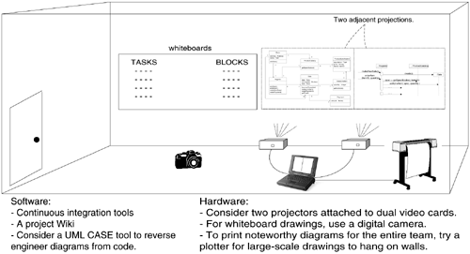
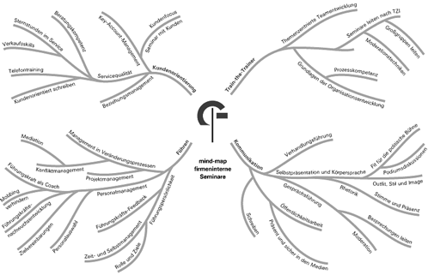
Sample XP Room for Collaboration, Communication and Brainstorming
Source: (T1)

Slide 12
Summary: Agile Metrics & Tools
Metrics must be S.M.A.R.T (Specific/Simple, Measurable, Achievable, Relevant, Time-bound/Transparent)
Metrics are Specific/Tailored to Organizational Processes
Metrics to be Baselined before commencing Tracking for realistic assessment of Progress
Metrics are categorized under: Success Metrics, Time/Cost Metrics, and Satisfaction Metrics
Sprint Velocity and Capacity are the two Metrics for Planning/Estimating in Scrum
Task Boards and Open Rooms facilitate real-time communication of Metris to all members of Scrum Team
Project Wikis and CASE tools are some of the Tools for Knowledge Sharing in Scrum Team

Slide 13
Thank You
© Copyrights of original Authors are duly acknowledged
™ ® All Trademarks, Registered Trademarks referred in this document are the property of their respective owners

